Slide 1
FILE DESCRIPTORS BUILTIN COMMANDS SYSTEM ADMINISTRATION

Slide 2
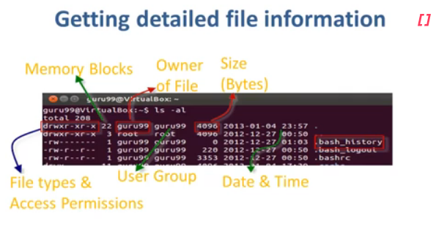

Slide 3
What are File Descriptors?
File Descriptors are non-negative integers that act as an abstract handle to “Files” or I/O resources (like pipes, sockets, or data streams) . These descriptors help us interact with these I/O resources and make working with them very easy.
Every process has it’s own set of file descriptors.

Slide 4
stdin: Standard Input denoted by the File Descriptor 0
stdout: Standard Output denoted by the File Descriptor 1
stderr: Standard Error denoted by File Descriptor 2

Slide 5
Types of Commands
External or built-in commands
Built-in commands are internal commands that are built-in the shell. Built-in commands are called from the shell and executed directly within the shell itself. You can list all built-in commands with the help of 'help' and 'compgen -b' command. Some example of built-in commands are 'pwd', 'help', 'type', 'set', 'unset', etc.
External commands are other than built-in commands. These commands are programs which have their own binary and located in the filesystem. These are the commands that your system offer and are totally shell independent. Mostly these commands reside in /bin, /sbin, /usr/sbin.

Slide 6
type command
Linux 'type' command tell us whether a command given to the shell is a built-in or external command.
Syntax:
type <command>
Example:
type pwd
type cd
type man
type cat
type file

Slide 7
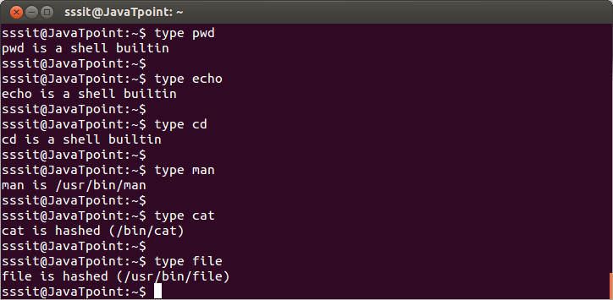

Slide 8

Look at above snapshot, commands like 'pwd' and 'cd' are built-in commands while commands 'man', 'cat', and 'file' are external commands.
Linux 'type' command also tells whether a command is aliased or not.
Example:
type ls

Slide 9
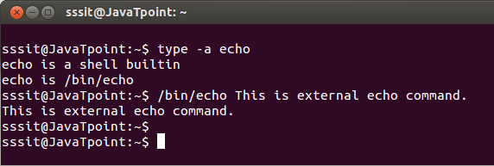
type -a
The 'type -a' option tells about all type of command whether it is built-in, external, or aliased. Some commands are both external and built-in commands. But built-in command will always takes priority until and unless path of external command is mentioned.
Syntax:
type -a <command>
Example:
type -a echo
Look at the above snapshot, 'echo' command is internal as well as external. To use external 'echo' command, path "/bin/echo" is mentioned.

Slide 10
which
Linux 'which' command locates the path of a command.
Syntax:
which <command1> <command2> <command3>....
Example:
which ls pwd rmdir mkdir cp cd file man

Slide 11
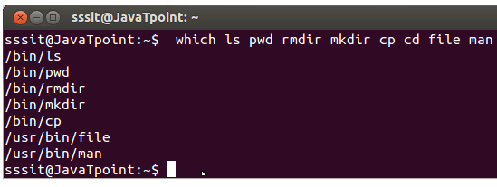
Look at the above snapshot, except 'cd' command, all other commands are external commands because bash has displayed their external path.

Slide 12
Linux - User Administration
There are three types of accounts on a Unix system −
Root account
This is also called superuser and would have complete and unfettered control of the system. A superuser can run any commands without any restriction. This user should be assumed as a system administrator.
System accounts
System accounts are those needed for the operation of system-specific components for example mail accounts. These accounts are usually needed for some specific function on your system, and any modifications to them could adversely affect the system.
User accounts
User accounts provide interactive access to the system for users and groups of users. General users are typically assigned to these accounts and usually have limited access to critical system files and directories.

Slide 13
Managing Users and Groups
There are four main user administration files −
/etc/passwd − Keeps the user account and password information. This file holds the majority of information about accounts on the Unix system.
/etc/shadow − Holds the encrypted password of the corresponding account. Not all the systems support this file.
/etc/group − This file contains the group information for each account.
/etc/gshadow − This file contains secure group account information.

Slide 14
Sr.No. | Command & Description
1 | useradd Adds accounts to the system
2 | usermod Modifies account attributes
3 | userdel Deletes accounts from the system
4 | groupadd Adds groups to the system
5 | groupmod Modifies group attributes
6 | groupdel Removes groups from the system

Slide 15
Create a Group
We will now understand how to create a group. For this, we need to create groups before creating any account otherwise, we can make use of the existing groups in our system. We have all the groups listed in /etc/groups file.
All the default groups are system account specific groups and it is not recommended to use them for ordinary accounts. So, following is the syntax to create a new group account −
groupadd [-g gid [-o]] [-r] [-f] groupname

Slide 16
Sr.No. | Option & Description
1 | -g GID The numerical value of the group's ID
2 | -o This option permits to add group with non-unique GID
3 | -r This flag instructs groupadd to add a system account
4 | -f This option causes to just exit with success status, if the specified group already exists. With -g, if the specified GID already exists, other (unique) GID is chosen
5 | groupname Actual group name to be created
$ groupadd developers

Slide 17
Modify a Group
To modify a group, use the groupmod syntax −
$ groupmod -n new_modified_group_name old_group_name
To change the developers_2 group name to developer, type −
$ groupmod -n developer developer_2
Here is how you will change the financial GID to 545 −
$ groupmod -g 545 developer

Slide 18
Delete a Group
We will now understand how to delete a group. To delete an existing group, all you need is the groupdel command and the group name. To delete the financial group, the command is −
$ groupdel developer
This removes only the group, not the files associated with that group. The files are still accessible by their owners.

Slide 19
Create an Account
Let us see how to create a new account on your Unix system. Following is the syntax to create a user's account −
useradd -d homedir -g groupname -m -s shell -u userid accountn

Slide 20
Modify an Account
The usermod command enables you to make changes to an existing account from the command line. It uses the same arguments as the useradd command, plus the -l argument, which allows you to change the account name.
For example, to change the account name mcmohd to mcmohd20 and to change home directory accordingly, you will need to issue the following command −
$ usermod -d /home/mcmohd20 -m -l mcmohd mcmohd20

Slide 21
Delete an Account
The userdel command can be used to delete an existing user. This is a very dangerous command if not used with caution.
There is only one argument or option available for the command .r, for removing the account's home directory and mail file.
For example, to remove account mcmohd20, issue the following command −
$ userdel -r mcmohd20
If you want to keep the home directory for backup purposes, omit the -r option. You can remove the home directory as needed at a later time.

Slide 22
Right Conduct | Peace | Truth | Love | Non -Violence
Manners | Patience | Truthfulness | Kindness | Consideration
Health Awareness | Concentration | Creativity | Friendship | Cooperation
Helpfulness | Positivity | Honesty | Forgiveness | Global Stewardship
Responsibility | Self Acceptance | Determination | Generosity | Loyalty
Independence | Self Discipline | Fairness | Compassion | Active Citizenship
Perseverance | Thankfulness | Trust | Tolerance | Justice
Courage | Contentment | Reflection | Service | Respect

Slide 23
Labour
qualified.
Artist

